Slide 1
Are we set up for financial success?
Lucien H. Fuertes
Bethel School of Technology

Slide 2
Agenda
My Background
Project Introduction
Methods Used
Results
Summary
Conclusions
Questions

Slide 3
Agenda
My Background
Project Introduction
Methods Used
Results
Summary
Conclusions
Questions

Slide 4
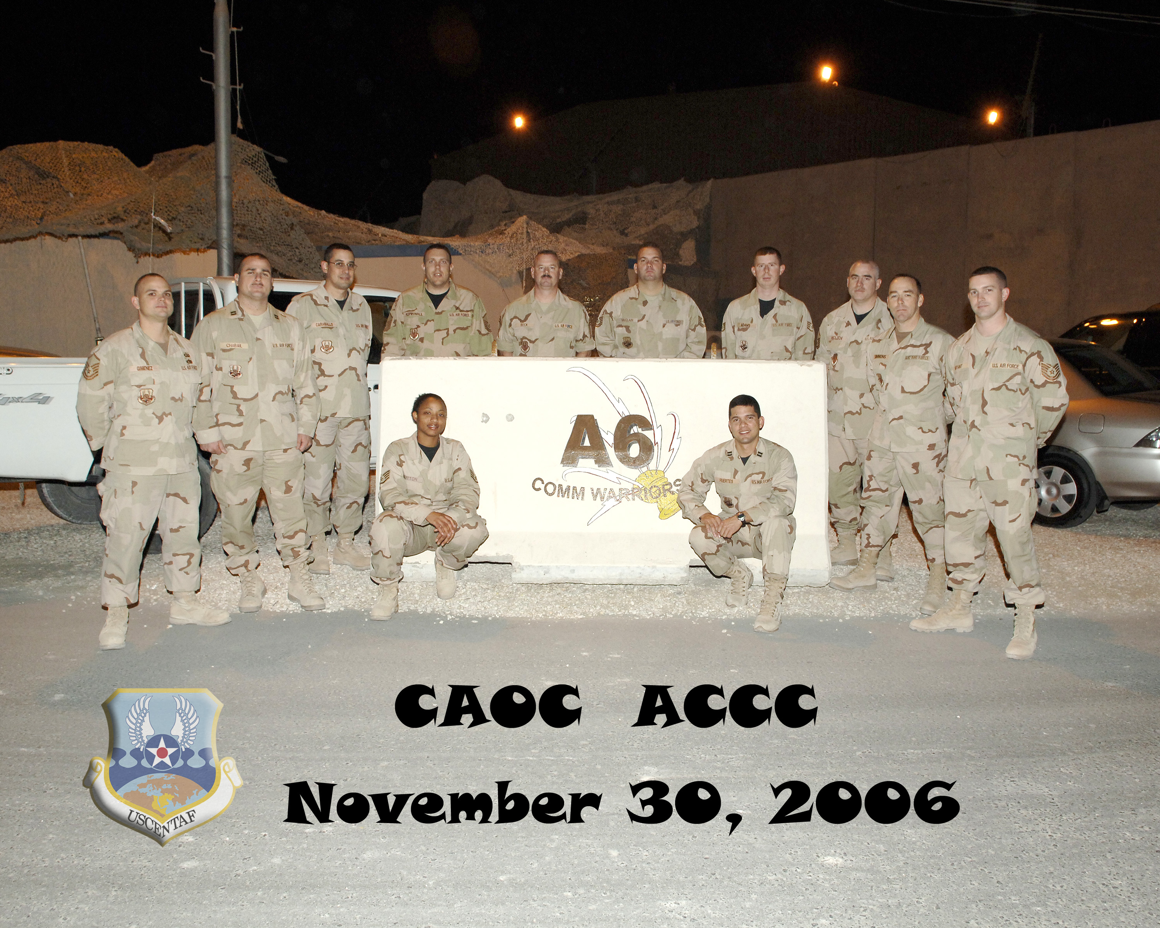




My Background
Previous Education: Computer Science Bachelor’s Degree & MIS
Previous Employment: US Air Force (Active Duty & Civilian)
Current Employment: Software Developer (SQL) – CyraCom International Language Solutions
Other Interests: Personal Finance Coach, Competitive Cyclist, Church Small Groups

Slide 5
Agenda
My Background
Project Introduction
Methods Used
Results
Summary
Conclusions
Questions

Slide 6

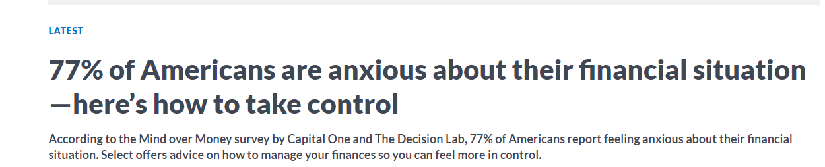
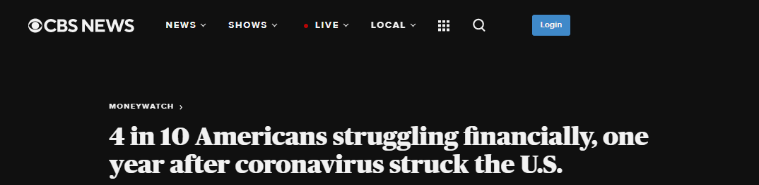
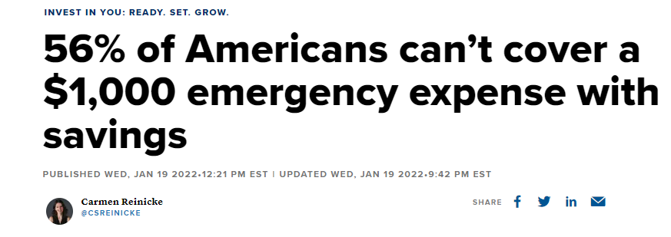
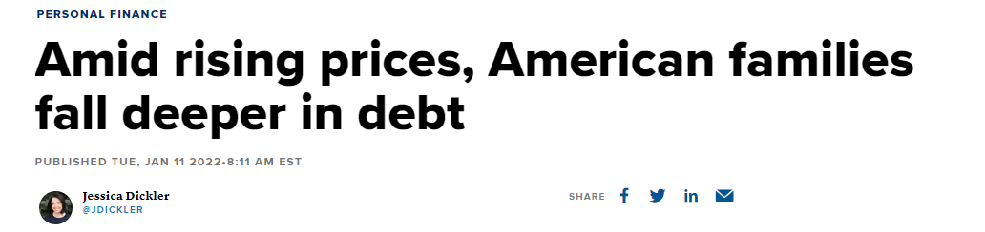
Project Introduction
Today’s Headlines in America

Slide 7
Purpose
Draw insights from the Consumer Financial Protection Bureau’s 2016 Financial Well-being survey
To gain understanding on what behaviors, habits or factors influence a healthy or poor financial well-being
Understand what Financial Well-being is

Slide 8
What is Financial Well-Being?
Financial well-being is a state of being wherein a person can fully meet current and ongoing financial obligations, can feel secure in their financial future and is able to make choices that allow them to enjoy life.
More specifically, an individual’s financial well-being corresponds to the extent to which the individual feels that he or she:
(1) has control of day-to-day and month-to-month finances;
(2) has the capacity to absorb a financial shock;
(3) is on track to meet financial goals; and
(4) has the freedom to make choices that allow enjoyment of life.

Slide 9
Agenda
My Background
Project Introduction
Methods Used
Results
Summary
Conclusions
Questions

Slide 10
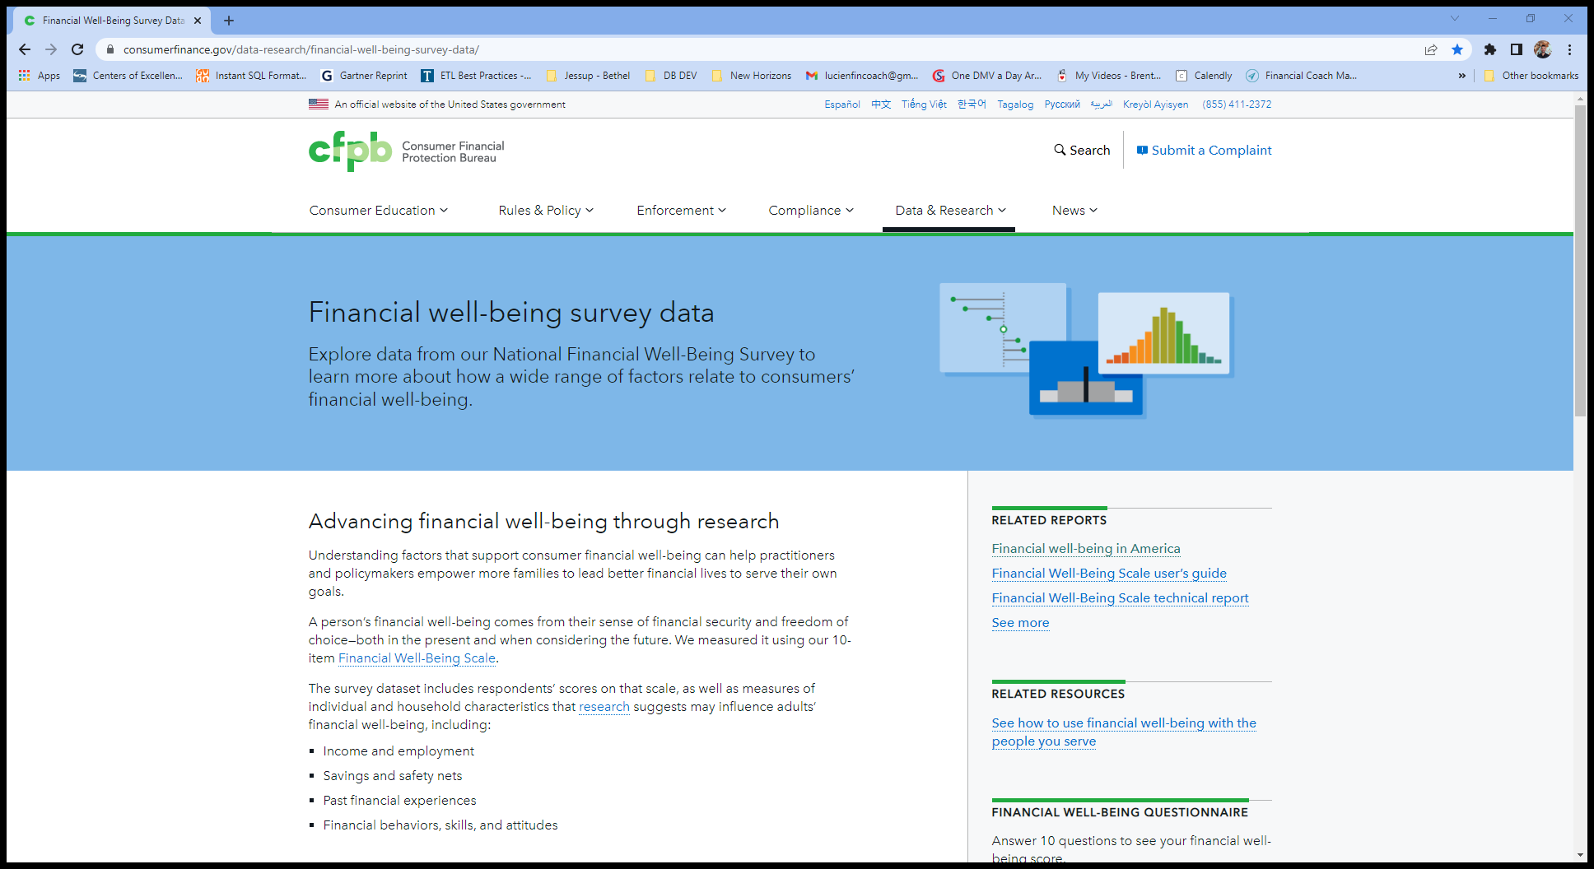
Data
The National Financial Well-Being Survey was conducted in English and Spanish via web mode between October 27, 2016 and December 5, 2016.
Sample size: 6,394
Total Variables: 217
Key variables used:
FWBscore – financial well-being score
FSscore – financial skill score
FS1_7 – can make myself save
SAVINGSRANGES – current money saved
PAREDUC – parent’s highest education
PPINCIMP – participant’s current household income
FINGOALS – has or had financial goals
CHANGEABLE - Belief that ability to manage money is NOT changeable
ABSORBSHOCK - Confidence in ability to raise 2,000 in the next 30 days
SELFCONTROL_3 - I am able to work diligently toward long-term goals
PEM - Everyone has a fair chance at moving up the economic ladder
https://www.consumerfinance.gov/data-research/financial-well-being-survey-data/

Slide 11
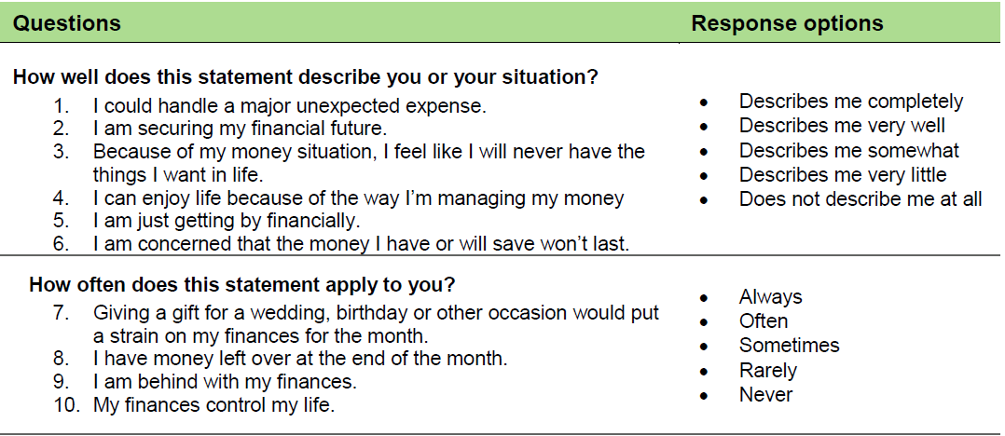
How is Financial Well-Being measured?
The CFPB Financial Well-Being Scale consists of 10 items.19 An individual’s responses to each of the 10 items in the scale are converted into a single score.

Slide 12
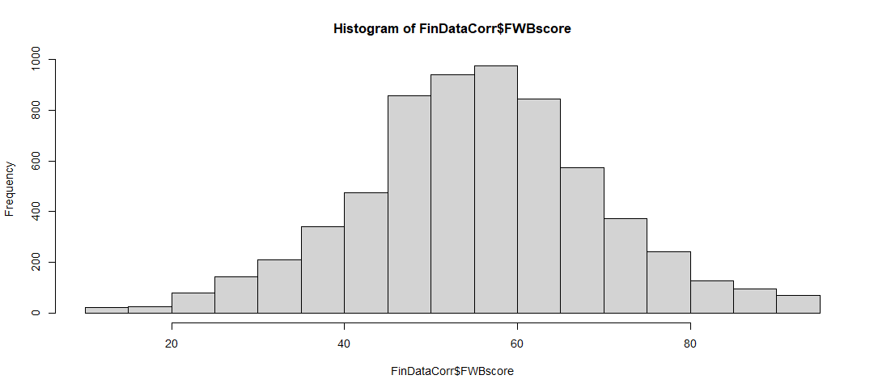
How’s the Financial Well-being scores distributed?
Min: 14
Max: 95
Mean: 56.08
Median: 56
Basic Statistics

Slide 13
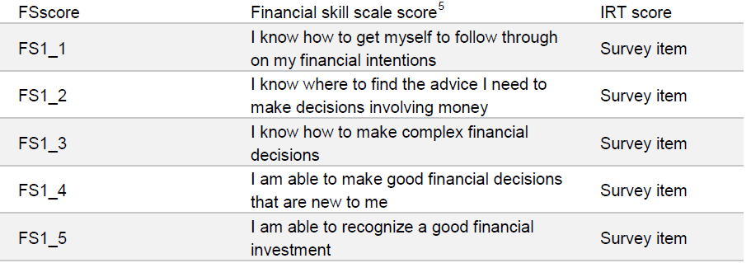
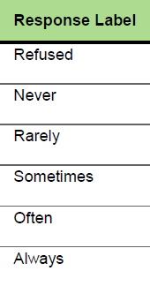
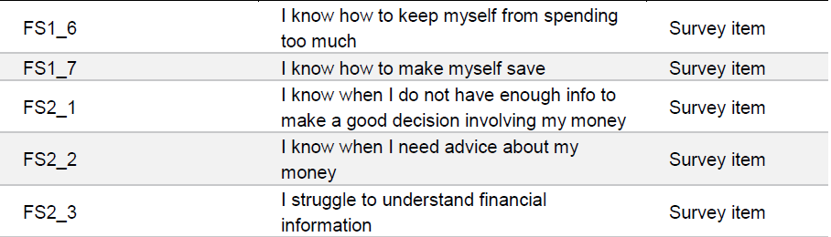
How is Financial skill measured?

Slide 14
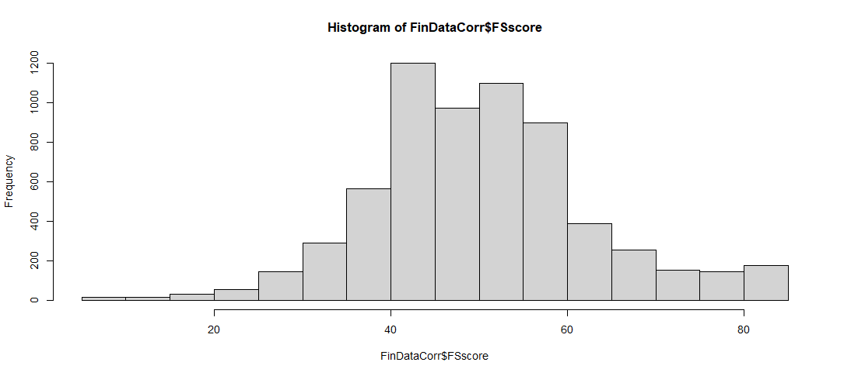
How’s the Financial skill scale scores distributed?
Min: 5
Max: 85
Mean: 50.78
Median: 50
Basic Statistics

Slide 15
Methods Used
Tools
Data Wrangling
RStudio
Jupyter Notebooks
Sub-setting (selecting only the needed variables into a new dataset
Filtering (removing unwanted values like negative values form the dataset)
Removing NA or missing values
Recoding
Variable renaming
Analyses
One-Way Between Subject ANOVA
Independent Chi-Square
Pearson's product-moment correlation
K nearest neighbors prediction

Slide 16
Agenda
My Background
Project Introduction
Methods Used
Results
Summary
Conclusions
Questions

Slide 17
Results
Evaluation Questions
Q1. How does the Financial Skill score correlate to the Financial Well-being score?
Q2. How does FS1_7 "I know how to make myself save" correlate to SAVINGSRANGES “how much money do you have in savings today”?
Q3. How does PAREDUC Influence current income PPINCIMP?
Q4. Is there a difference in PPINCIMP based on whether the participant sets FINGOALS or not?
Q5. How does the FWBscore compare between the top third and bottom third income brackets?
Q6. Can we predict Financial Well-being Score category (High, Medium or Low) based on the following variables:
CHANGEABLE , ABSORBSHOCK, SELFCONTROL_3, PEM, PPEDUC

Slide 18
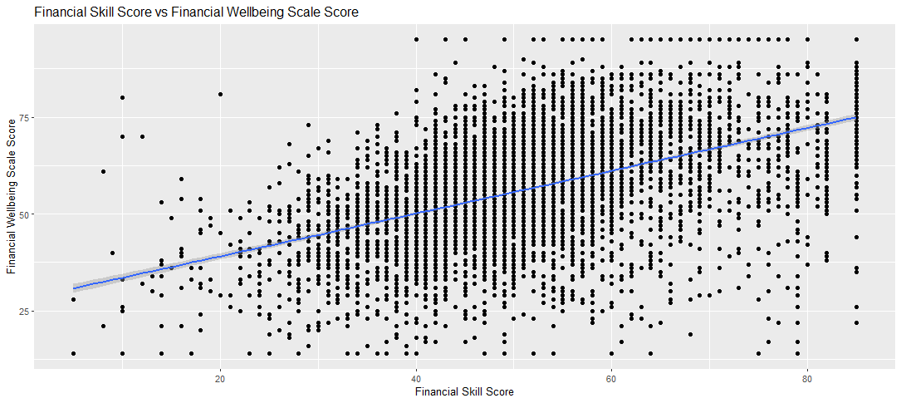
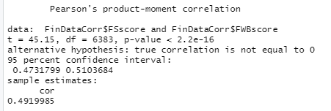

Q1. How does the Financial Skill score correlate to the Financial Well-being score?
Correlation:
49% - Medium

Slide 19
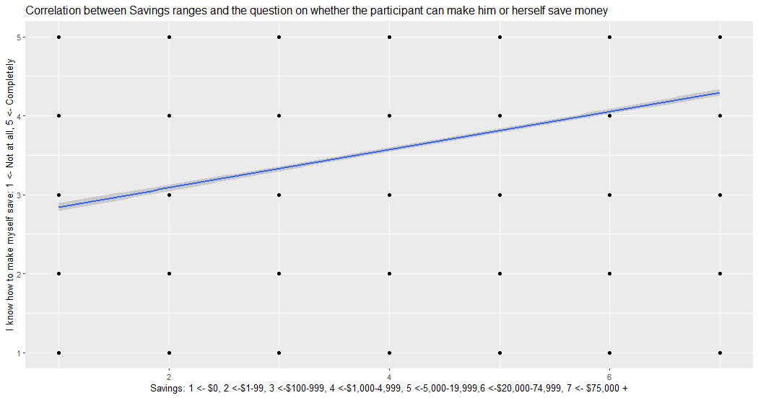
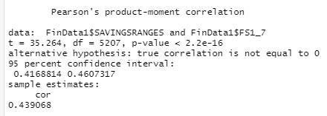

Q2. How does FS1_7 "I know how to make myself save" correlate to SAVINGSRANGES “how much money do you have in savings today”?
Correlation:
44% - Medium

Slide 20
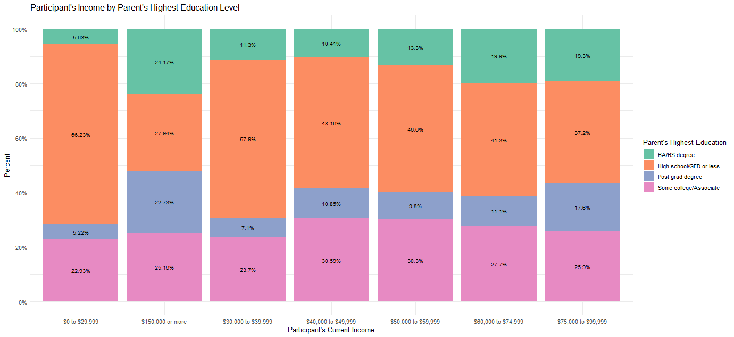




Q3. How does PAREDUC Influence current income PPINCIMP?

Slide 21
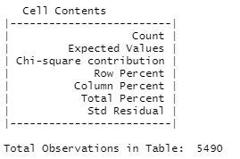
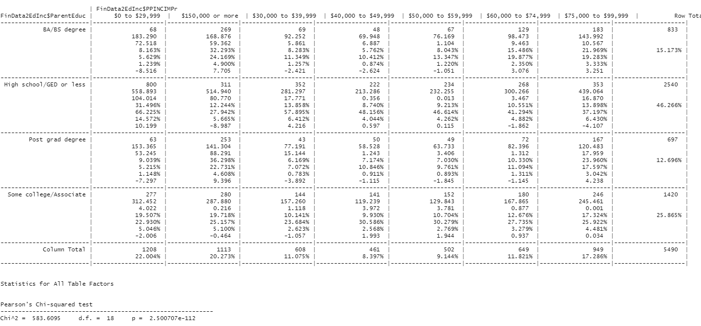








Q3 Cont… Independent Chi-Square Analysis – Crosstable

Slide 22
Q3 Cont… Independent Chi-Square Analysis – Post Hocs
Post Hocs Interpretation - absolute value of 2 or more is significantly different than the expected value.
For parents with high school or less, more participants earn $30k or less than expected and less participants earn more than $150k than expected.
For parents with some college/associates degree, less participants earn $30K or less than expected but just barely.
For parents with Bachelors degree, less participants earn $30k or less than expected and more earn $150K than expected.
For parents with a post grad degree, less participants earn $30K or less than expected and more participants earn $150K or more than expected.

Slide 23
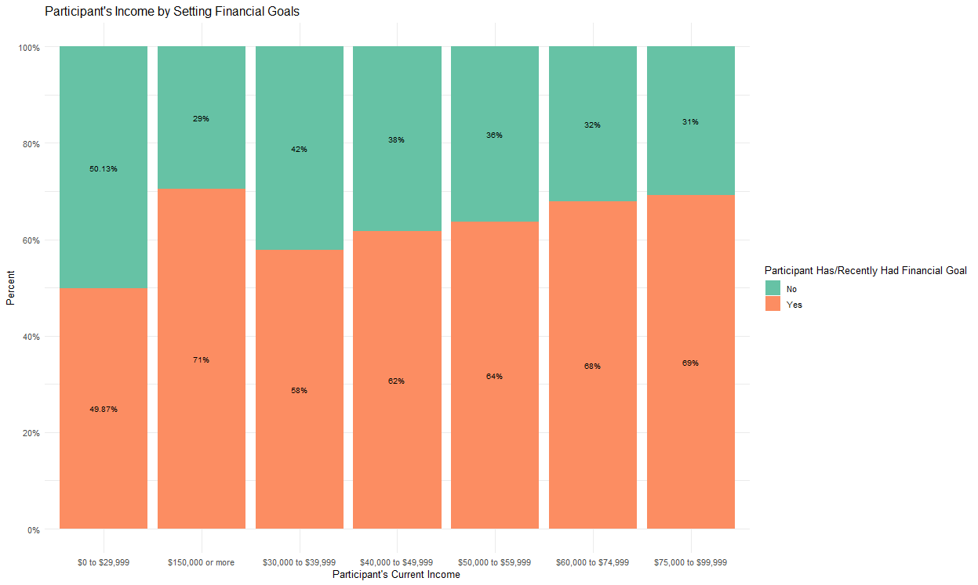
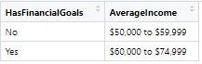

Q4. Is there a difference in PPINCIMP based on whether the participant sets FINGOALS or not?
One-Way Between Subject ANOVA
P values = 2e-16

Slide 24
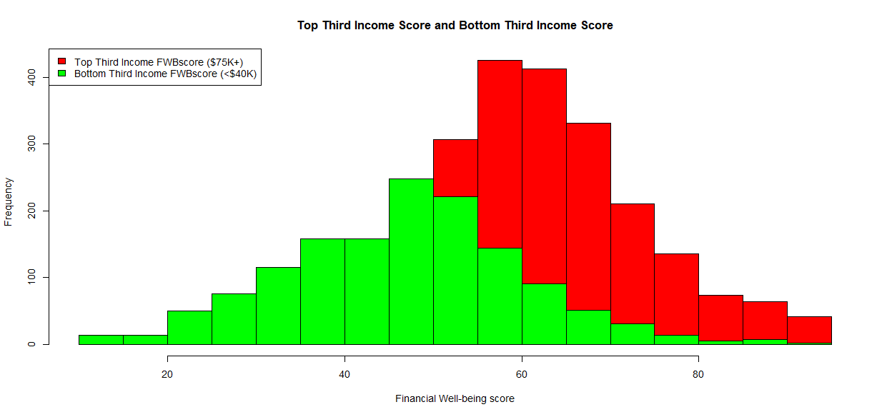
Q5. How does the FWBscore compare between the top third and bottom third income brackets?
Financial Well-being score by income
Income bracket | Mean | Median
Top 3rd | 60.96 | 61
Bottom 3rd | 47.24 | 48

Slide 25
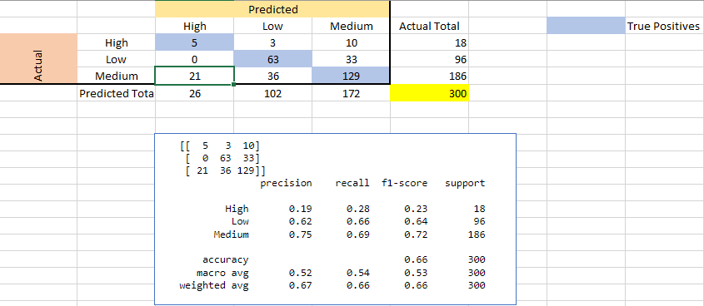
Q6. Can we predict Financial Well-being Score category ( High, Medium or Low) based on the following variables:
CHANGEABLE - Belief that ability to manage money is NOT changeable
ABSORBSHOCK - Confidence in ability to raise 2,000 in the next 30 days
SELFCONTROL_3 - I am able to work diligently toward long-term goals
PEM - Everyone has a fair chance at moving up the economic ladder
PPEDUC - Education (Highest Degree Received)
K nearest neighbors analysis with k = 1

Slide 26
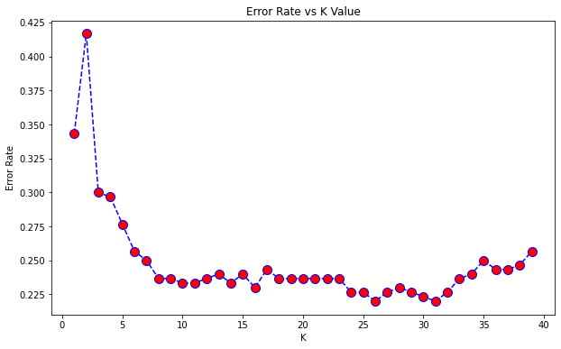


Q6 Calculating the error rate to find the best model
Ran iterations to find the best model
The lowest error rate is for k values of 26 and 31 – error rate of 22%
The original k = 1 value has an error rate of 42%

Slide 27
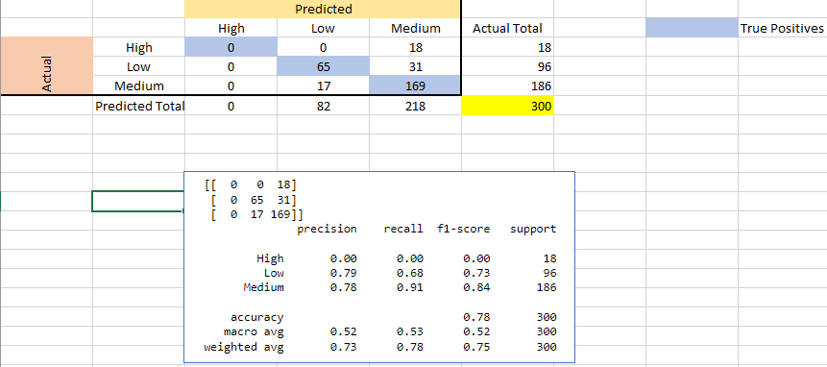
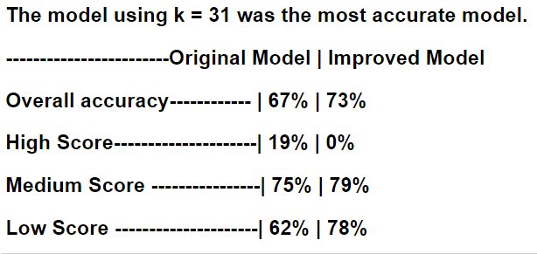
Q6 K nearest neighbors with K = 31
K nearest neighbors analysis with k = 31

Slide 28
Agenda
My Background
Project Introduction
Methods Used
Results
Summary
Conclusions
Questions

Slide 29
Summary
Q1 positive correlation (49%) between the Financial Well-being score and the Financial skill score
Q2 positive correlation (44%) between the variable “I know how to make myself save” and the current savings of the participant
Q3 the higher the level of education of the parents, the higher the participant’s income and vice-versa
Q4 the higher the participant’s income, the higher the percent that sets financial goals
Q5 participants in the top third income bracket have higher Financial Well-being scores compared to the participants in the bottom third income bracket
Q6 ML model is 73% accurate when predicting the Financial Well-being score

Slide 30
Agenda
My Background
Project Introduction
Methods Used
Results
Summary
Conclusions
Questions

Slide 31
Conclusions
Q1. The financial skill of the participants positively correlated to the financial well-being score, however the skill score increased faster than the well-being score meaning that participants may be a little over confident in their skills
Q2. The participants savings amount correlated positively with their perceived ability that they can save. Their savings ranges increased faster than their perceived ability to save
Q3. Participant’s parents education level, significantly influences the participant’s current income
Q4. Setting financial goals seem to lead to higher income
Q5. The higher the financial well-being score, the higher the participant’s income and vice-versa, the lower the financial well-being score, the lower the participant’s income
Q6. CHANGEABLE, ABSORBSHOCK, SELFCONTROL_3, PEM, PPEDUC are not great variables to predict the participant’s financial well-being score. Overall accuracy of the best model is 73%

Slide 32
Agenda
My Background
Project Introduction
Methods Used
Results
Summary
Conclusions
Questions

Slide 33
Questions?

